Slide 1
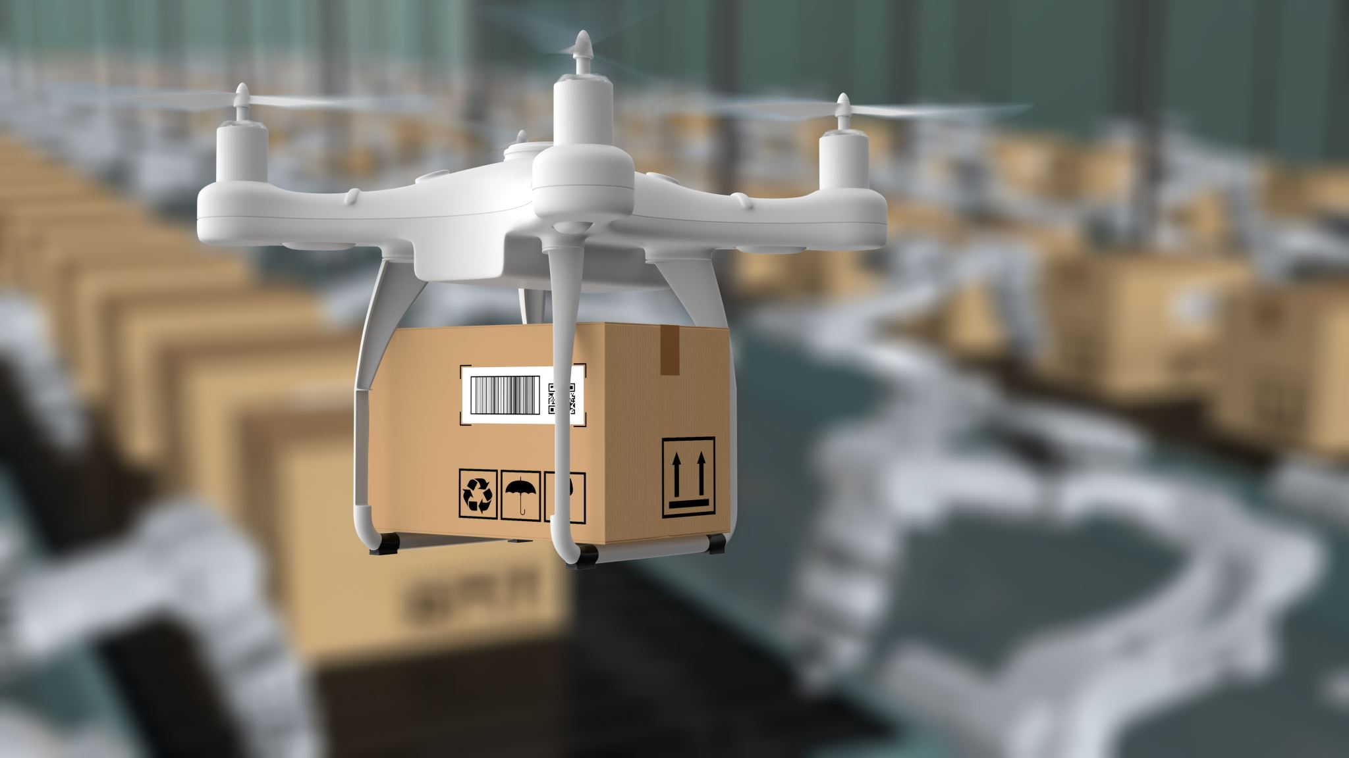
Order Fulfillment
By: Jordan Dubreil
Ryan Perkins
Kaumil Patel
David Eister

Slide 2
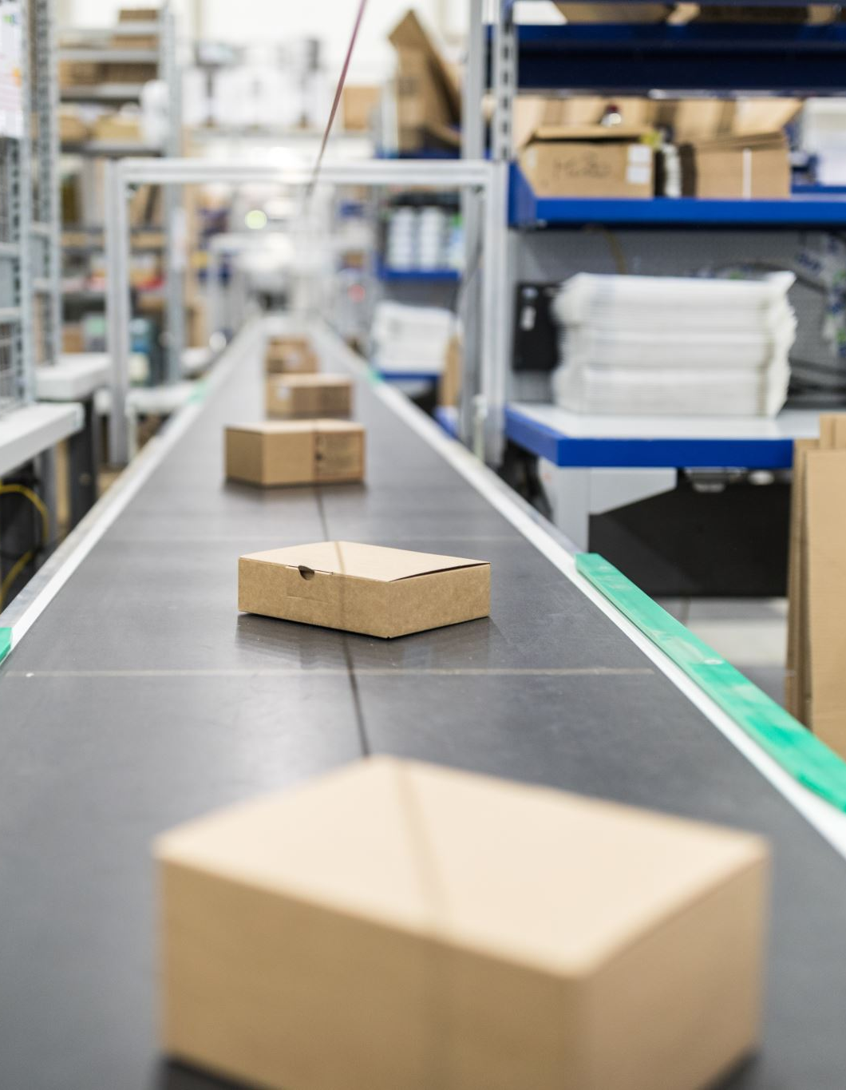
Business Process
An important part of any business is ensuring that the products that are provided are delivered in a reasonable time.
Allows us to work efficiently and give us a competitive advantage.
Create customer loyalty and satisfaction leads to more revenue

Slide 3
High Level Dimensional Model
Business Process Name | Fact Table | Fact Grain Type | Granulairty | Facts | dim customer | dim date
Order Fulfillment | fact order fulfillment | Accumulating Snapshot | One row per order (across all products on order) | quantityoforder daysfromordertoshipped daysfromordertorequired shippedrequireddetla shippedontime | x | x

Slide 4
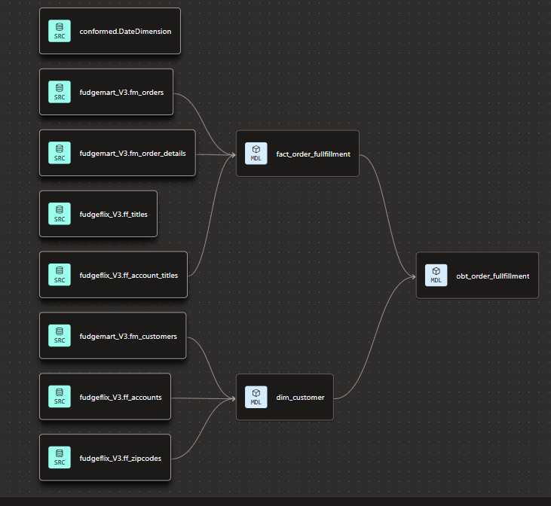
Order fulfillment
Created a Star schema that connects our fact table to our customers
Orders could have been another dimension but did not directly affect the order process

Slide 5
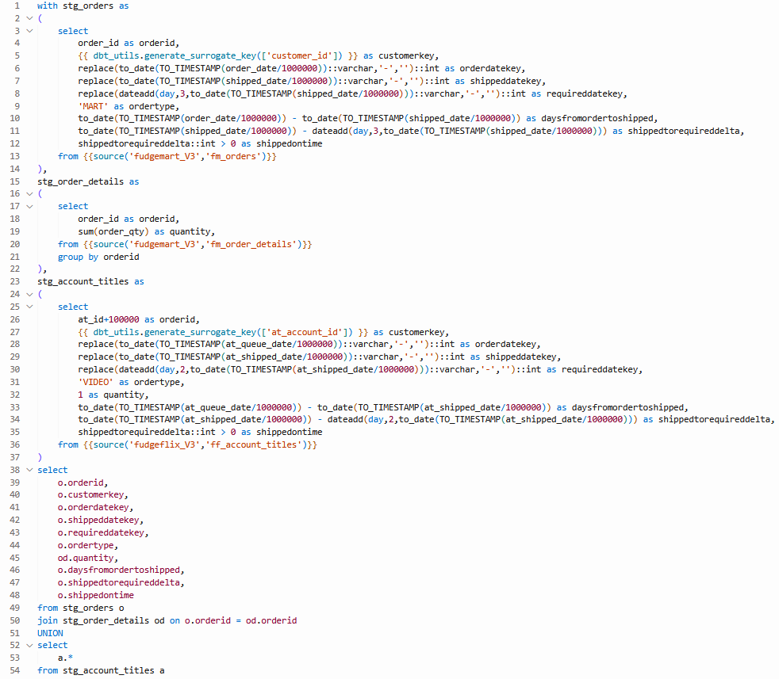
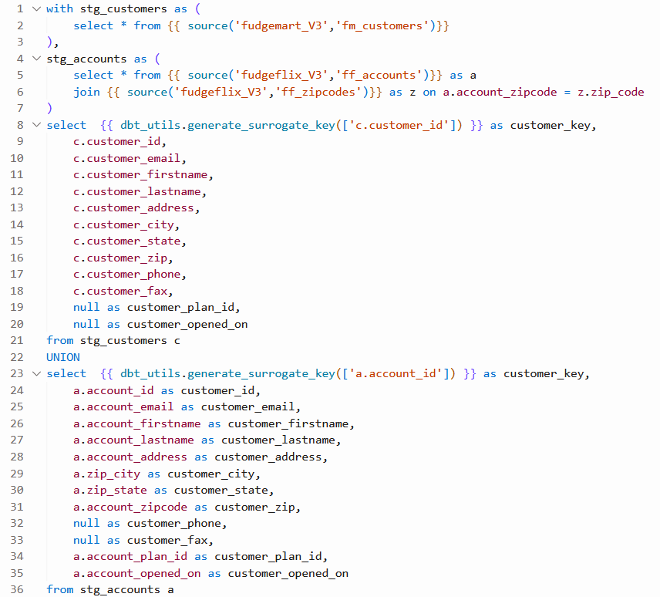
Dim & Fact Table

Slide 6
Parameters and Success
We defined success as being able to successfully deliver Fudgemart products within 3 days and FudgeFlix in 2 days.
Time from order to shipping
Shipping to required delivery date

Slide 7
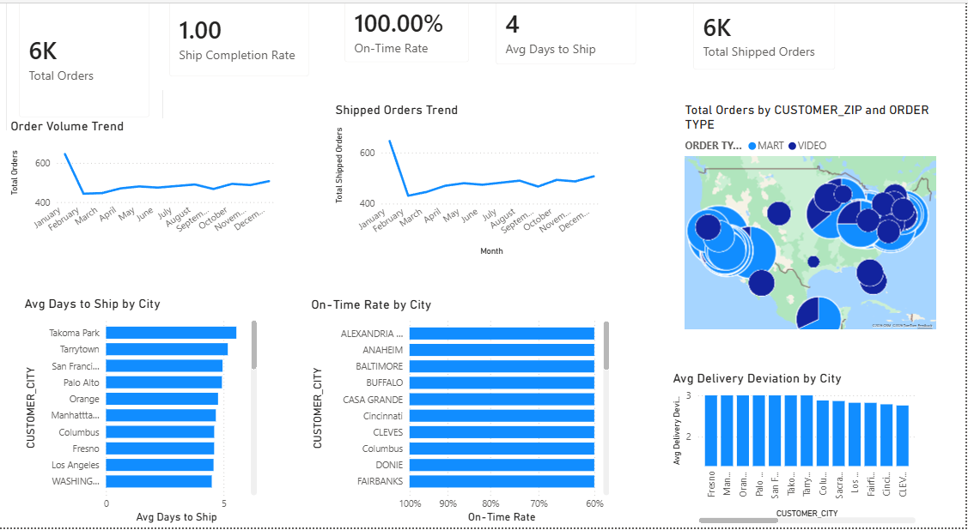
Business Intelligence
Data to guide decisions

